Slide 1
My Holiday PowerPoint

Slide 2
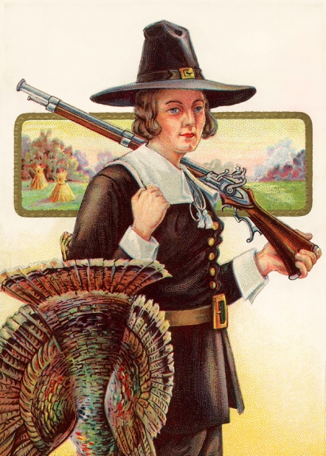
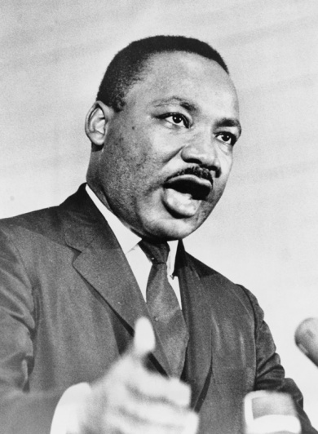
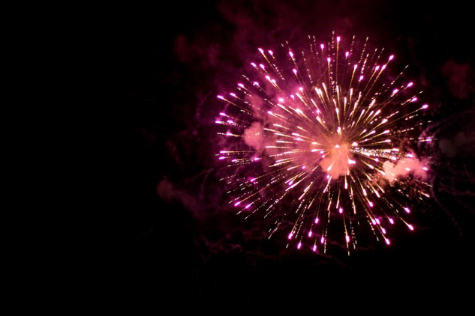

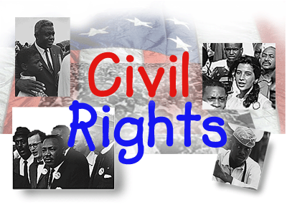
Thanksgiving
Sharing harvest with American Indians
Observed in January
America’s Birthday
Observed in November
Observed in July
Observed in February
Honor all US Presidents
Fourth of July
People treated fairly
Remember African American man

Slide 3
Martin Luther King Jr Day
Sharing harvest with American Indians
Observed in January
America’s Birthday
Observed in November
Observed in July
Observed in February
Honor all US Presidents
Fourth of July
People treated fairly
Remember African American man

Slide 4
Presidents’ Day
Sharing harvest with American Indians
Observed in January
America’s Birthday
Observed in November
Observed in July
Observed in February
Honor all US Presidents
Fourth of July
People treated fairly
Remember African American man

Slide 5
Independence Day
Sharing harvest with American Indians
Observed in January
America’s Birthday
Observed in November
Observed in July
Observed in February
Honor all US Presidents
Fourth of July
People treated fairly
Remember African American man

