Slide 1
SWOT Analysis for Individuals
C. W. Von Bergen
Southeastern Oklahoma State University

Slide 2
SWOT Analysis for Individuals
“Those with keen understanding of their strengths and needs are in much better position than those with limited or faulty self-knowledge.
—Howard Gardner, Frames of Mind
Employment counselors and career development specialists should be familiar with this approach.
From strategic planning
S—strength
W—weakness
O—opportunity
T—threat
Perspectives
Internal (strengths, weaknesses)
External (opportunities, threats)
Notes:
Noted author, Howard Gardner, is a keen observer of human behavior said:
Some self-reflection is important.
<number>

Slide 3
Strategic Planning and SWOT Analysis
From strategic planning
S—strength
W—weakness
O—opportunity
T—threat
Perspectives
Internal (strengths, weaknesses)
External (opportunities, threats)

Slide 4
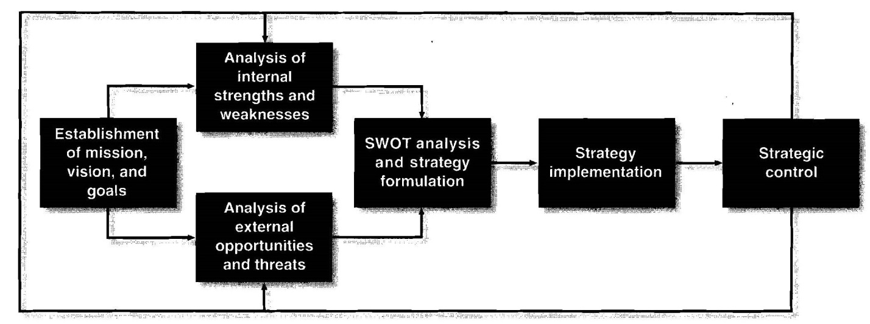
The Strategic Management Process

Slide 5
A SWOT Analysis
… serves to uncover the optimal match between the internal strengths and weaknesses of a given firm and the environmental trends (opportunities and threats) that the business must fact in the marketplace.
The most well-known strategic planning tool.

Slide 6
SWOT Analysis for Individuals
Many business students are familiar with the idea of SWOT analysis since it is much discussed in business curriculum
The rise of the Protean career
Workers must take more control of their careers
Employees must look out for their own employability
People must periodically reinvent themselves
Individuals must develop competitive skills needed in the marketplace
Notes:
Douglas Hall talked about the Protean career a number of years ago:
Derived from the Greek god Proteus, who could change shape at will
Employability is considered an alternative to job security
Implement a strategic management process at the individual level
The protean career is a process which the person, not the organization, is managing. It consists of all of the person’s varied experiences in education, training, work in several organizations, changes in occupational field, etc. The protean person’s own personal career choices and search for self-fulfillment are the unifying or integrative elements in his or her life.
<number>

Slide 7
Personal SWOT
Combination of …
Self-assessment tool
Strategic planning activity
And Created …
In light of an individual’s personal mission statement
Their vision of where they see themselves in the future
Notes:
Personal mission statements:
<number>

Slide 8
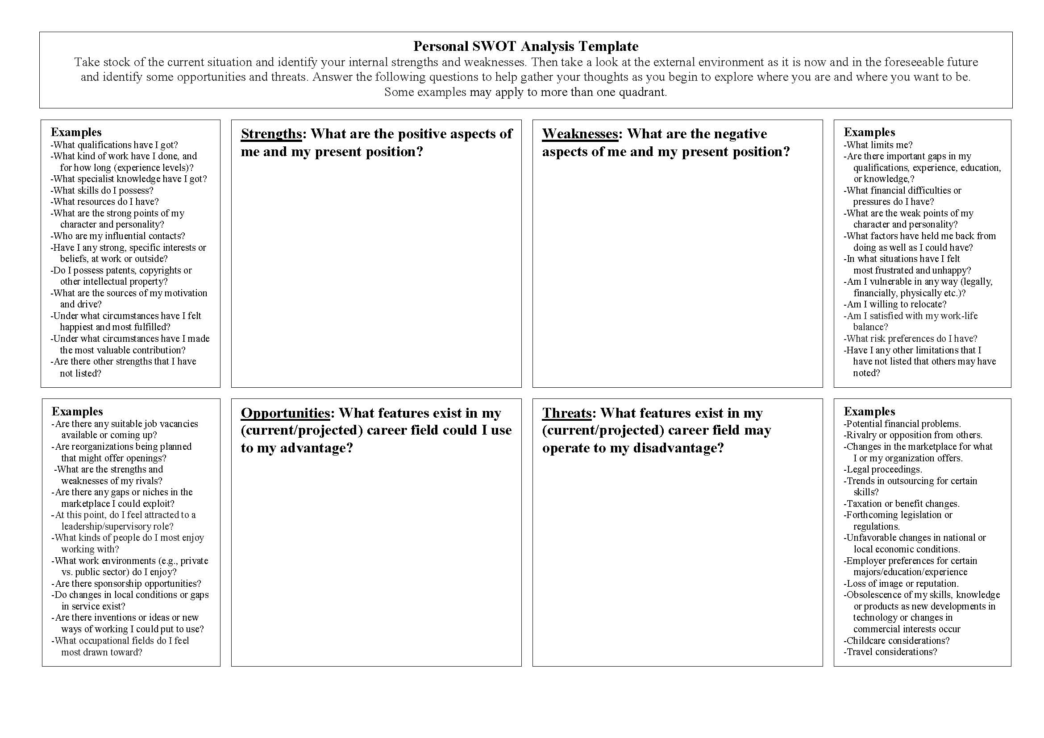
Personal SWOT Analysis Template
Notes:
Pass out handout of this to audience.
<number>

Slide 9
Primary Misuse of SWOT
The failure to link outcomes of SWOT exercises to the rest of the planning system has been suggested as the key problem of the SWOT tool

Slide 10
Therefore …
Develop actions and action plans for moving forward and then evaluate and recalibrate

Slide 11
Personal SWOT Analysis …
Not the best thing since sliced bread, but pretty darn close

