Slide 1

He Whakapapa
Family Tree

Slide 2
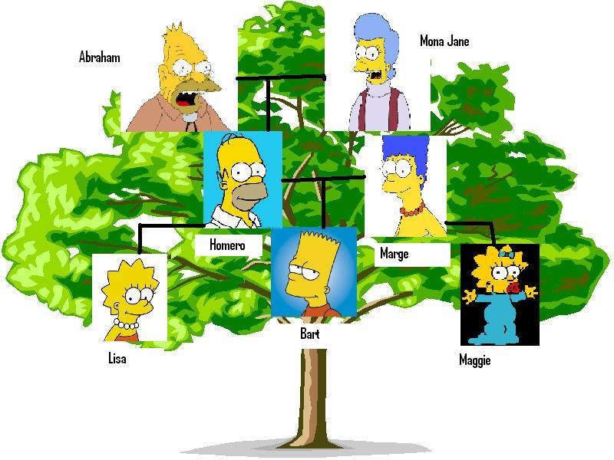
Examples of A Family Tree

Slide 3
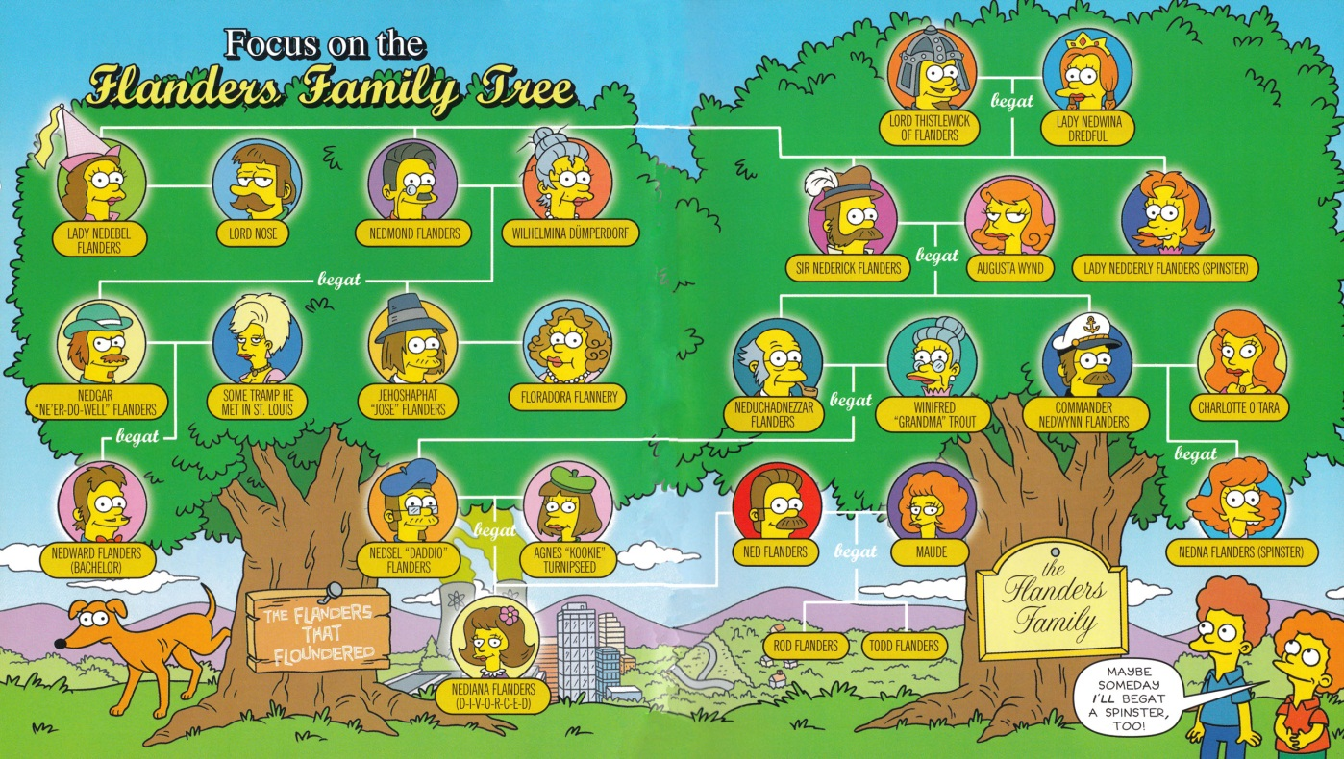
The Flanders Family tree

Slide 4
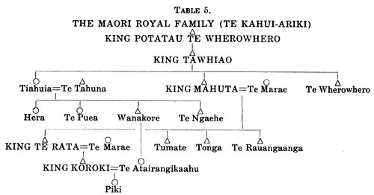
Te Kingitanga

Slide 5
