Slide 1
Minimal Prototype
Integrated Prototype
Integration
Validation
5/21/2015
2014
9/24/2014
12/20/2014
2015
4/1/2015
2014
25
30
35
40
45
50
3
8
13
18
23
28
2015
6/18/2014
Today
7/31/2015
Kick-Off
Submission
Requirements
27 days
6/25 - 7/21
Validation
35 days
7/5 - 8/8
Data Analysis
39 days
7/25 - 9/1
Architectural Review
34 days
8/11 - 9/13
System Design
42 days
8/25 - 10/5
Database
38 days
9/7 - 10/14
Data Improve
26 days
9/25 - 10/20
Coding
63 days
10/15 - 12/16
Website Testing
20 days
12/12 - 12/31
Online Testing
36 days
1/2 - 2/6
Coding
85 days
1/15 - 4/9
System Testing
25 days
3/25 - 4/18
Stabilization
32 days
4/1 - 5/2
Performance Enhancing
36 days
4/18 - 5/23
Integration with Website
32 days
5/30 - 6/30
User Acceptance Testing
20 days
6/14 - 7/3
Documentation
24 days
7/2 - 7/25
Stage 1 Submission
21 days
7/10 - 7/30

Slide 2
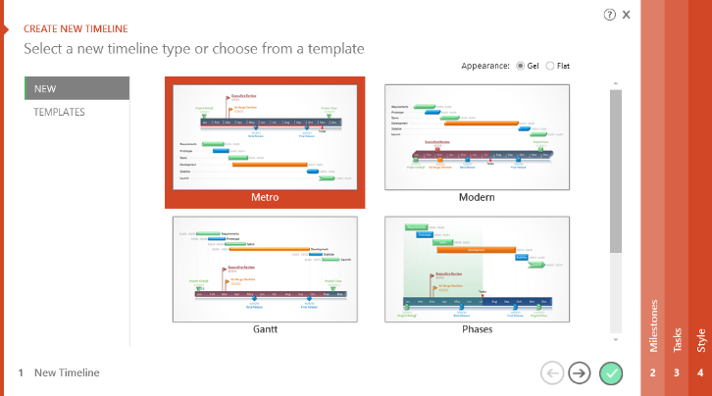
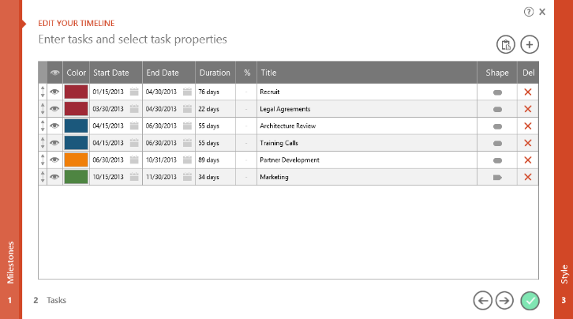
To change and update this template automatically,
download the free Office Timeline PowerPoint add-in!
Office Timeline is a free, award winning, Gantt chart maker that's easy to use.
Simple, easy-to-use wizards.
Professional, quick results.
Built directly into PowerPoint

