Slide 1
11 days
SECTION 1
May 19 - Jun 2
100%
4 days
Sub-task
5/19 - 5/23
3 days
Sub-task 2
5/26 - 5/28
3 days
Sub-task 3
5/29 - 6/2
11 days
SECTION 2
Jun 3 - Jun 17
65%
2 days
Sub-task 1
6/3 - 6/4
3 days
Sub-task 2
6/5 - 6/9
5 days
Sub-task 3
6/10 - 6/16
1 day
Sub-task 4 - zero duration
6/17
12 days
SECTION 3
Jun 18 - Jul 3
15%
4 days
Sub-task 1
6/18 - 6/23
3 days
Sub-task 2
6/24 - 6/26
5 days
Sub-sections 1
6/27 - 7/3
4 days
Sub-sub-task 1
6/27 - 7/2
1 day
Sub-sub-task 2
7/3
2015
2015
Week 1
2
3
4
5
6
7
2015
Today
Sat May 23
Thu Jun 18
Milestone 2
Wed Jun 3
Milestone 4
Fri Jul 3
Tue May 19
Milestone 3
Milestone 5
Milestone 1

Slide 2
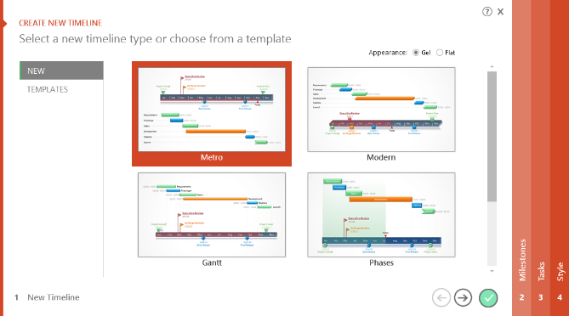
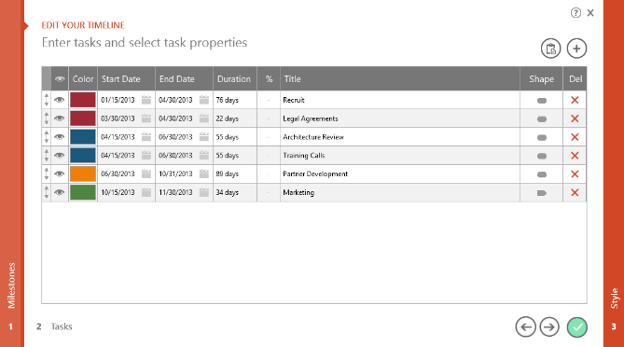
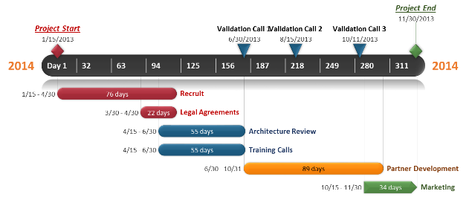
To change and update this template automatically,
download the free Office Timeline PowerPoint add-in!
Office Timeline is a free, award winning, Gantt chart maker that's easy to use.
Simple, easy-to-use wizards.
Professional, quick results.
Built directly into PowerPoint

